Slide 1
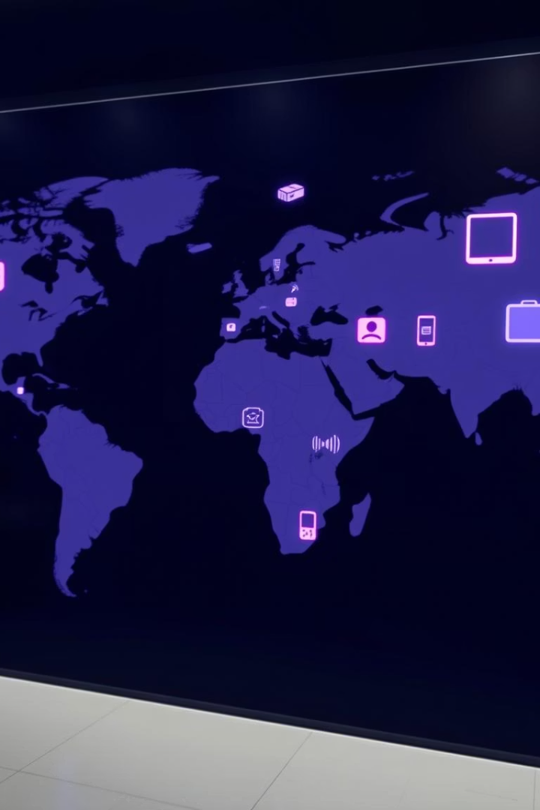
Global Tech Gadget Consumption: Trends & Insights using Power BI
Explore global gadget consumption from 2015 to 2025. Metrics cover sales, adoption, spending, e-waste, and connectivity. This overview is based on extensive market research reflecting fast-changing tech trends worldwide.
by Arihant Jain

Slide 2

Objective
The objective of this project is to analyze
global trends in gadget adoption
technology penetration across various countries and years.
key metrics such as smartphone sales, laptop shipments, gaming console adoption, smartwatch penetration, average consumer spending on gadgets, e-waste generation, and 5G penetration rates,
this analysis aims to uncover insights into consumer behavior, technological advancement, and environmental impact.
The findings will help stakeholders understand market dynamics, identify high-growth regions, and make informed decisions to balance innovation with sustainability.

Slide 3

Dataset overview
Country – Name of the country.
Year – Year of data.
Smartphone Sales (Millions) – Number of smartphones sold.
Laptop Shipments (Millions) – Number of laptops shipped.
Gaming Console Adoption (%) – % of people using gaming consoles.
Smartwatch Penetration (%) – % of people using smartwatches.
Avg. Consumer Spending ($) – Average annual spending on gadgets per person.
E-Waste Generated (Metric Tons) – Total electronic waste produced.
5G Penetration Rate (%) – % of population with 5G access/use.

Slide 4

Process Making Dashboard in power BI

Slide 5

Load the data
Data Cleaning & Preparation
Create Relationships (if multiple tables)
Create Dax Measures
Format the Dashboard
Build Visualizations

Slide 6
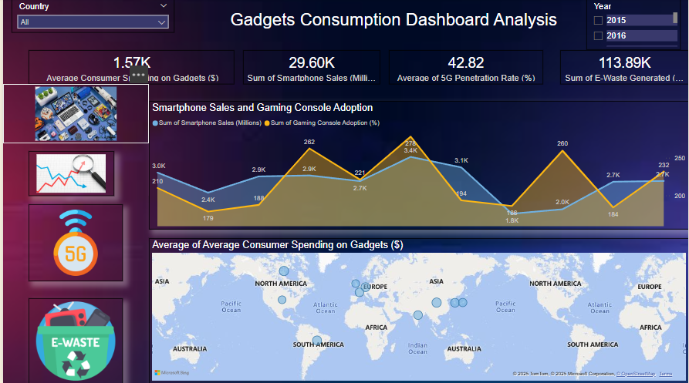

Slide 7
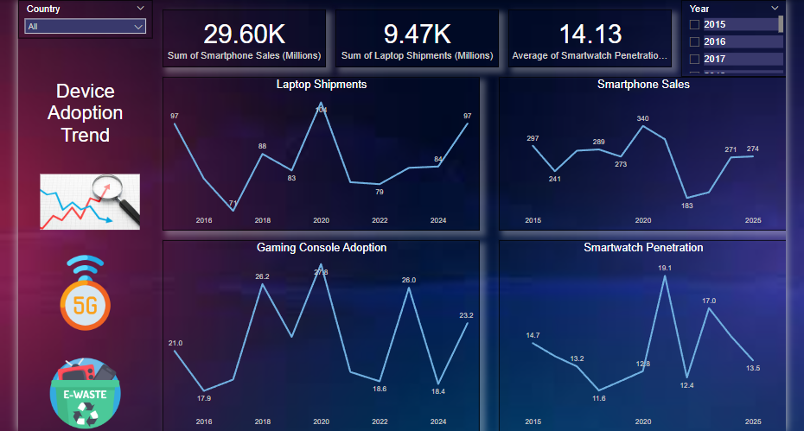

Slide 8
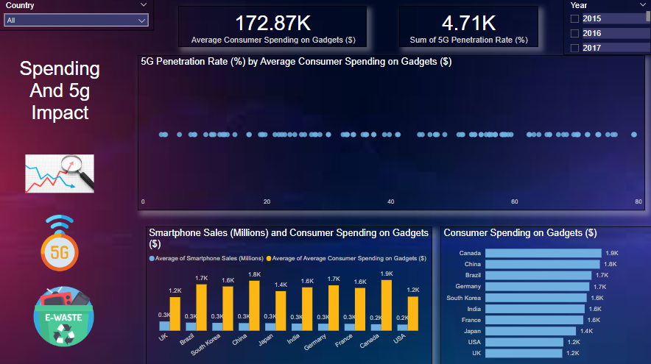

Slide 9
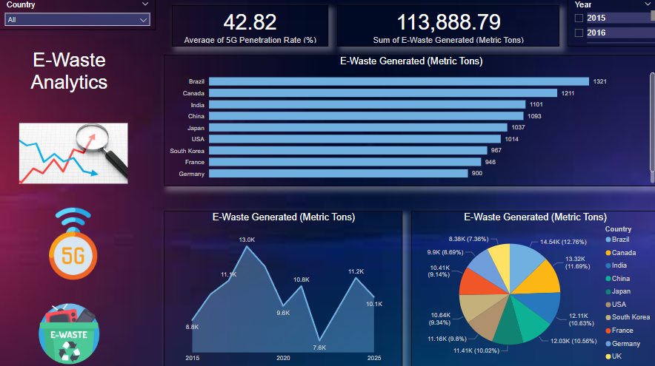

Slide 10

Rising Technology Adoption
Smartphone sales and laptop shipments have steadily
increased across most countries, reflecting a global shift
toward digital lifestyles
5G penetration is accelerating, especially in countries with high
smartphone and smartwatch usage.

Slide 11

5G Expansion Insights
Countries with early 5G penetration see a boost in both gadget
sales and smartwatch adoption, showing that 5G rollout may
drive hardware upgrades
Some countries have high smartphone sales but low 5G
penetration, suggesting either network lag or delayed infrastructure
investments.

Slide 12

Gadget Sales Trends
Shipment Trends
Smartphone sales have outpaced laptop shipments in nearly all countries, showing the global shift toward mobile-first connectivity.
Laptop shipments remain steady but show slight dips in certain years, possibly due to market saturation or economic constraints.

Slide 13

Spending vs. Adoption Gaps
In some countries, consumer spending is high but adoption rates are moderate, hinting at premium device preferences or smaller but affluent user bases.
Others exhibit high adoption and low spending, indicating markets driven by affordability, installment plans, or refurbished gadgets.

Slide 14

E-Waste Alarming Trends
A consistent increase in e-waste generation aligns with the rising gadget sales, pointing toward a growing environmental concern.
Countries with the highest e-waste output per capita also tend to show higher gadget refresh rates and tech obsession.

Slide 15

Conclusion: Key Trends and Future Outlook
Emerging markets will drive the next wave of tech adoption as infrastructure and affordability improve.
5G expansion will unlock new use cases in IoT, health tech, and real-time services.
Sustainability and recycling initiatives will become crucial in managing rising e-waste volumes.
Consumer personalization and smarter ecosystems (e.g., connected wearables) will shape buying behavior.

Slide 16

THANK YOU
ARIHANT JAIN
jainarihant0102@gmail.com

